Slide 1
Developing Extensions for JupyterLab

Slide 2



Meet the instructors
Piyush Jain AWS
Piyush is a software engineer working on JupyterLab
Alex Bozarth IBM
Alex is a software engineer working on Elyra and JupyterLab
Martha Cryan IBM
Martha is a software engineer working on Elyra and JupyterLab

Slide 3



Exploring Extensions
What are extensions?
Examples
DrawIO
Latex
Git
Spellchecker
Themes
Installing prebuilt vs source
Git
DrawIO
Notes:
What are extensions: JupyterLab is a web-based user interface for scientists and developers for exploration, analysis, and visualization. JupyterLab provides a Jupyter notebook editor, code editor, code console, terminal, debugger, and more as core extensions. Users can write and distribute extensions as Python packages to add new components or customize and extend the capabilities of existing components in JupyterLab. For example, users can install extensions that provide a new file viewer or editor, display data with custom visualizations inside notebooks or code consoles, or interact with external services and version control. Extensions can add items to the main menu, status bar, command palette, notebook metadata panel, activity launcher, side bars, context menus, toolbars, and keyboard shortcuts. Extensions can also provide new autocomplete results, custom themes, custom settings, and custom ipywidgets. Extensions can also provide extension points for other extensions.
Examples:
Latex
Drawio
Git
Spellchecker for markdown cells
Spreadsheets
Voila - turns notebooks into standalone applications
Ipywidgets - interactive widgets for notebooks
Custom themes
Google drive
lsp

Slide 4
Anatomy of an Extension
Extensions, plugins and widgets
Code Walkthrough…
We will be using an example created from https://github.com/jupyterlab/extension-cookiecutter-ts
The example is loosely based on the in-depth example found in the jupyterlab documentation: https://jupyterlab.readthedocs.io/en/stable/extension/extension_tutorial.html
Notes:
https://github.com/marthacryan/developing-extensions-tutorial

Slide 5
Code Exercise
Open examples/tutorial_extension dir in your IDE
Try adding a toolbar button that refreshes the image using the following hints:
- The toolbar can be accessed from MainAreaWidget.toolbar
- A ToolbarButton class can be found in @jupyterlab/apputils
An example answer can be found on the next slide if you get stuck

Slide 6
Code Exercise Example Answer
const button = new ToolbarButton({
icon: refreshIcon,
onClick: () => widget.load_image()
});
main.toolbar.addItem('refresh', button);

Slide 7
Debugging JupyterLab Extensions
When is debugging useful
Setting up for debugging
Launching JuyterLab for debugging
Setting breakpoints
Other ways to debug

Slide 8
When is debugging useful
To find errors in code
Investigating unexpected results
Understanding the code path
Learning internals of other extensions
Notes:
Find errors in code: You might have actual logic errors in the code which might be creating unexpected output, these errors might not be apparent on the UI, so it is useful to look at the state of objects/variables inside the code.
Don’t see expected output: These are scenarios where you observe that the extension you are working with is not working the way you expect, e.g., the UI elements are missing or the content is missing or user actions don’t update the content etc.
Code path: It is helpful to step into the core jupyterlab objects within your extension to see how they operate providing a greater insight into how they might be affecting your code.
Inspecting internals: You might want to look inside the code of other extensions and inspect available variables and objects to understand how these extensions are working.

Slide 9
How to know something has gone wrong
UI elements are missing
Errors appear in the server log
Errors appear in the browser console
Notes:
Most common symptom you will see is that the UI elements of your extension are missing, in other cases you might see that the content does not respond to user actions or the content is not as per your expectation.
In case of UI (javascript errors) issues, open the browser console and look for any exceptions or errors.
If there are no errors in the browser console, the next thing to do is open the server log (terminal console), and look for any errors in the log.
In some cases, after you have made changes on your server extension, there are more subtle errors in your code which causes the loading of server extension to fail altogether. It is hard to locate these errors in the server log, as these errors are present at the start of log. Also, these errors don’t provide any specific stacktrace because the extension fail to load. To discover these errors, run the following command in your terminal.
`jupyter server extension list`
This command will show the stacktrace and underlying error in the console.

Slide 10
Debugging in Visual Studio Code
Instructions are in DEBUGGING.md
Install the cookiecutter package pip install cookiecutter
Use the debug-config-cookiecutter cookiecutter ../debug-config-cookiecutter
Install the debug dependencies jlpm install
Build the extensions jlpm build
Notes:
Step by step instructions for setting up the debugger in vscode are present in DEBUGGING.md. I will also be walking through the steps here along with you, so it’s ok if you want to follow along with the instructions.

Slide 11
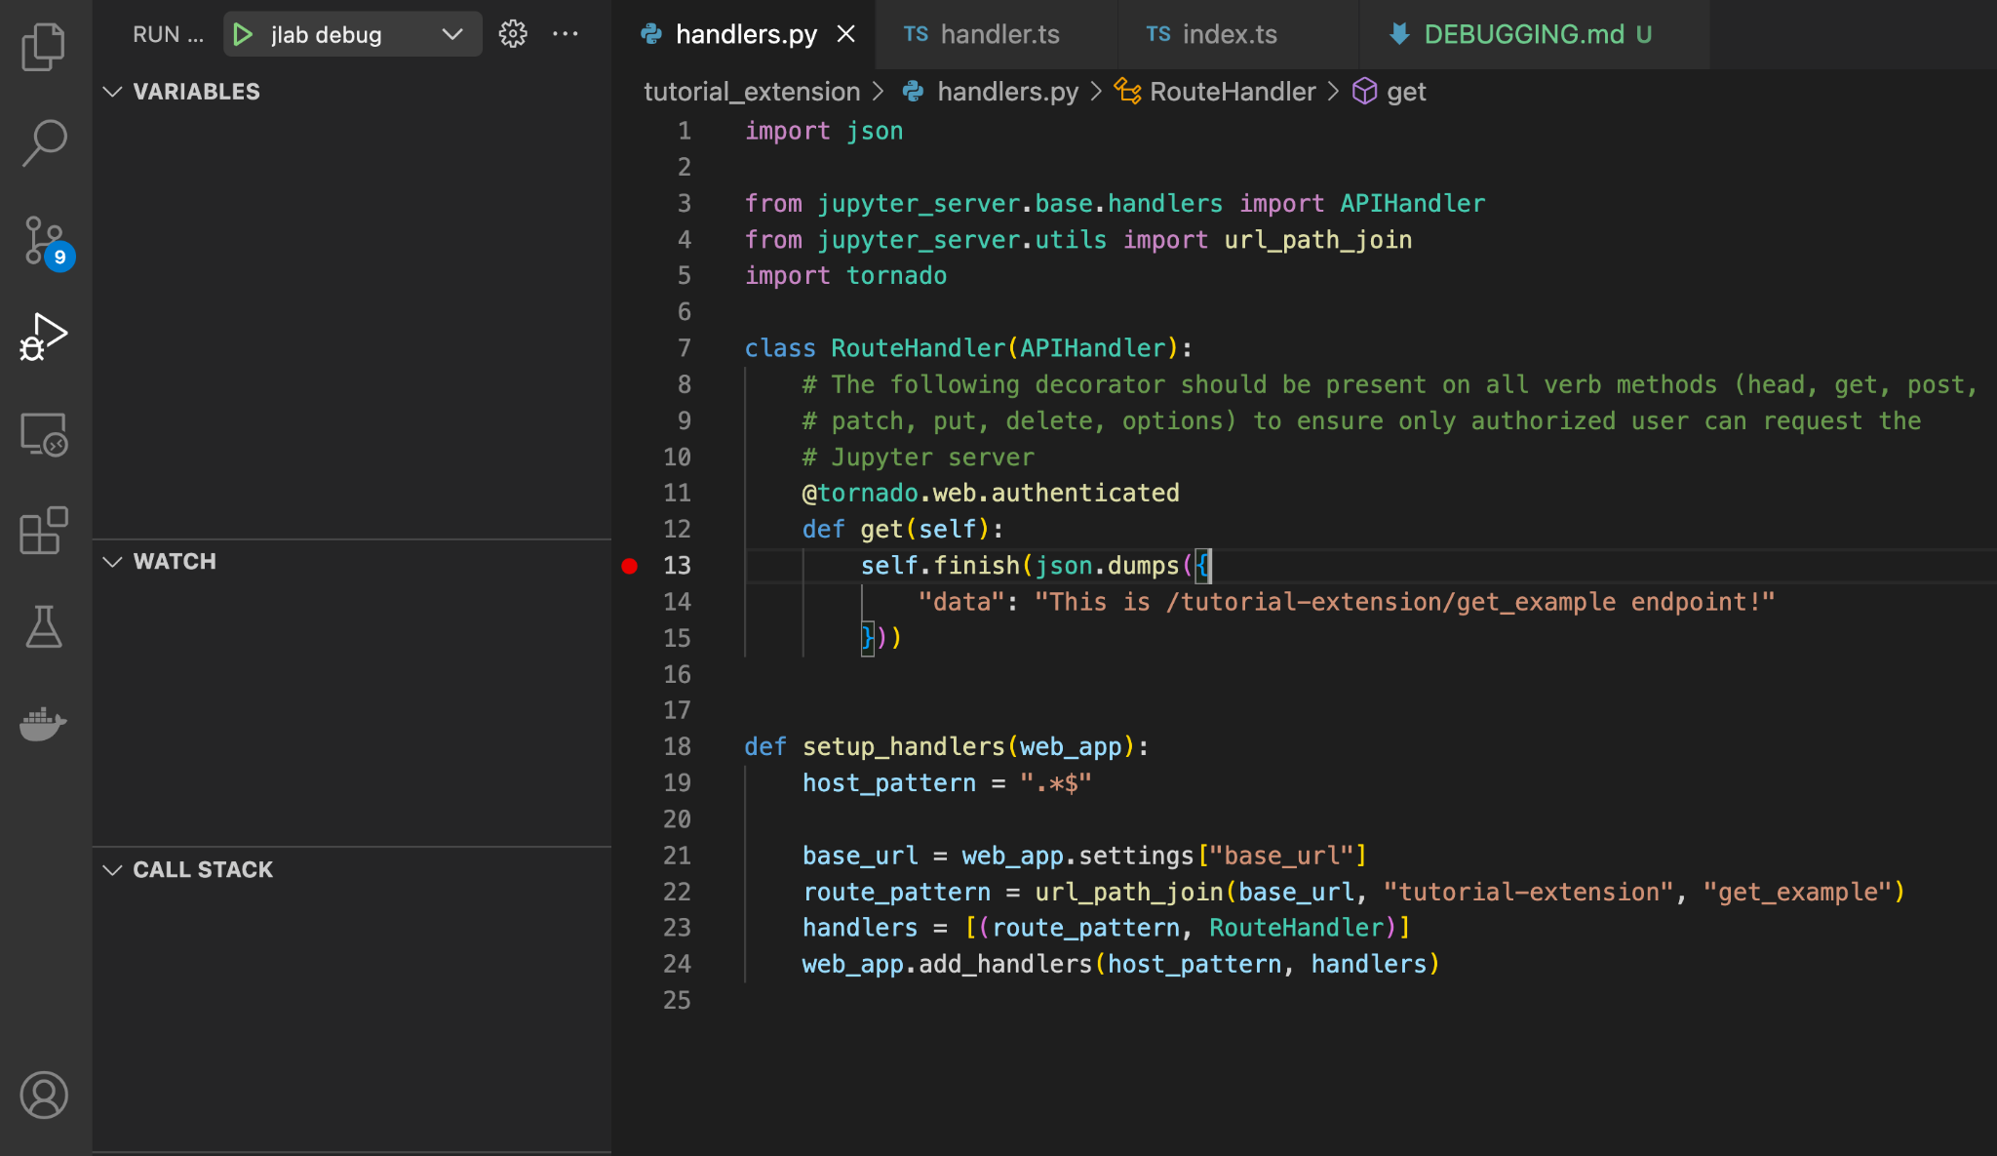
Setting breakpoints

Slide 12
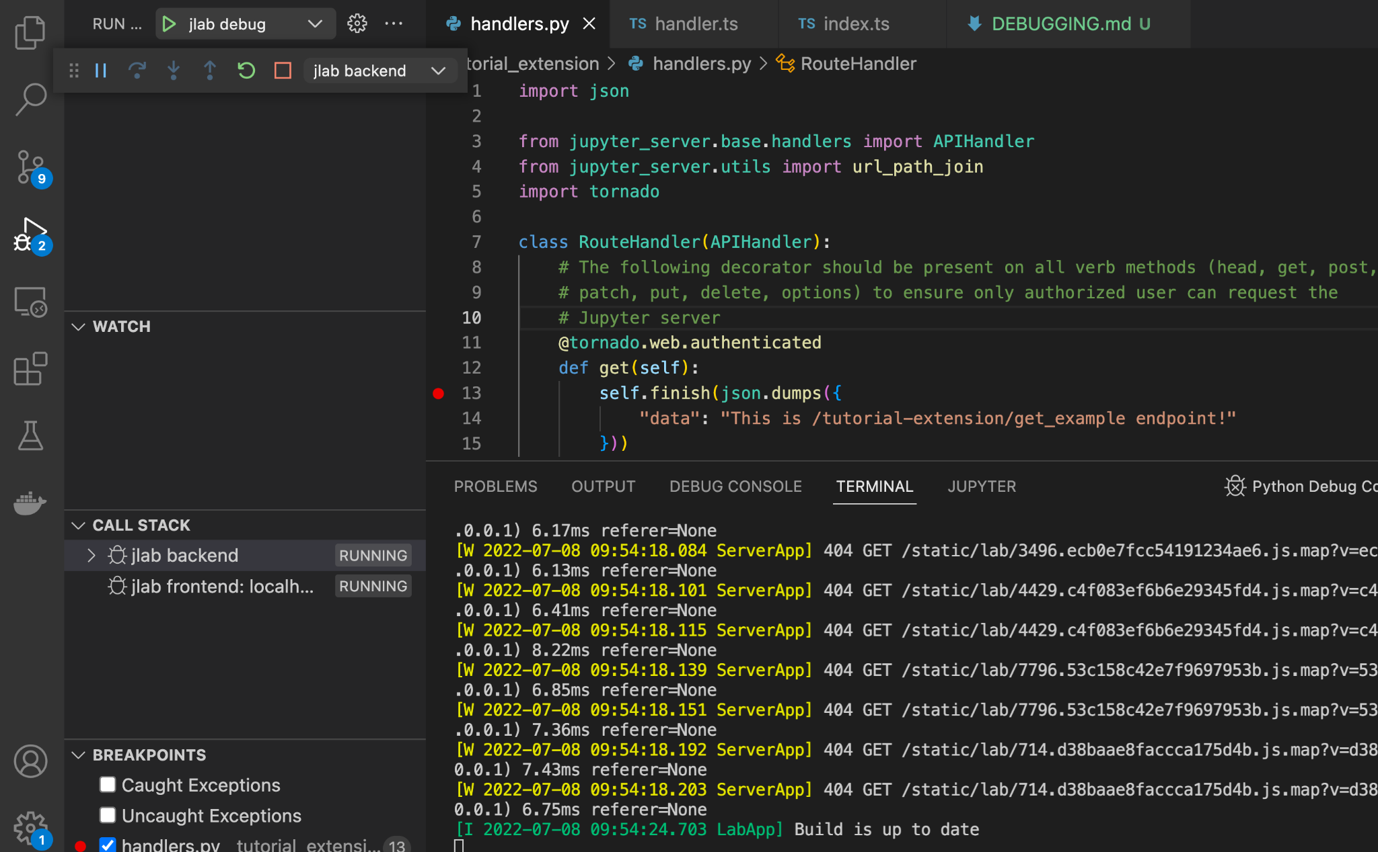
Launching JupyterLab for debugging

Slide 13
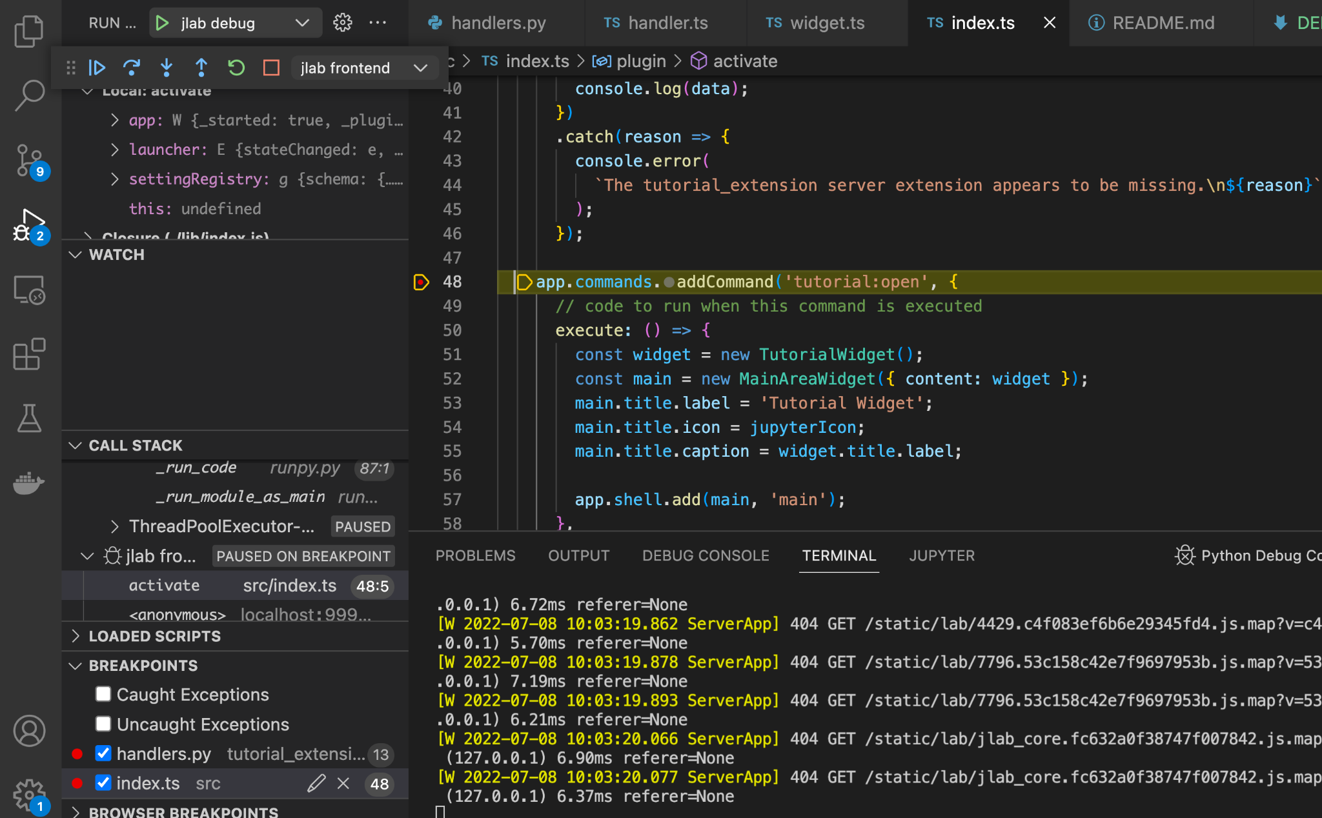
Debugging Front End Extension

Slide 14
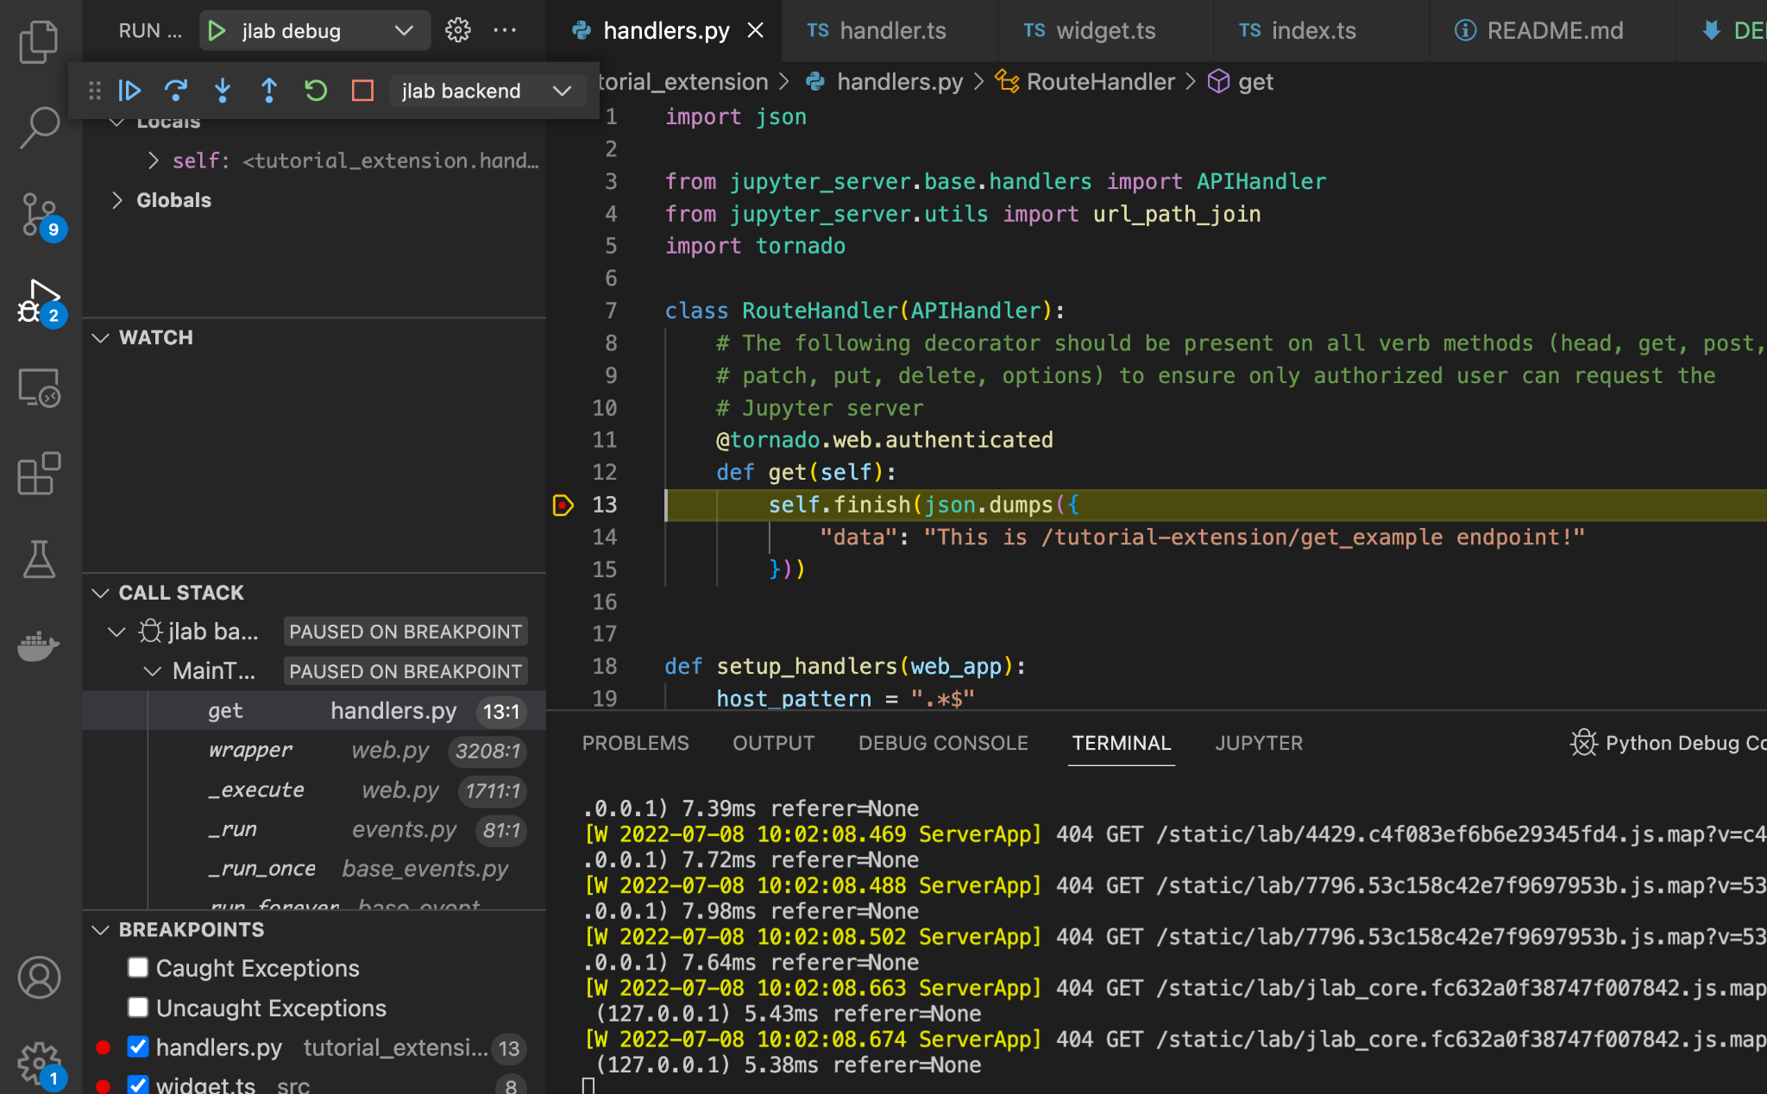
Debugging Server Extension

Slide 15
Other ways to debug
Front end extension
Use the browser directly to debug
Server extensions
Python’s command line debugger (pdb) import pdb; pdb.set_trace()
IPython pdb, a better alternative to pdb (pip install ipdb) import ipdb; ipdb.set_trace()

Slide 16
Working on Your Own Extension
Jupyter Server extension
Theme extension
Whatever you wanted to start on - or pick from here

